Slide 1
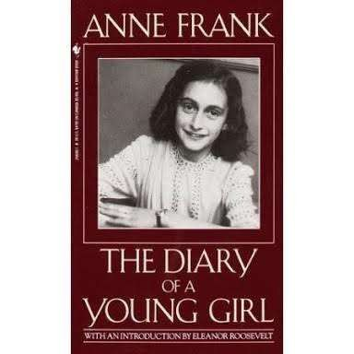
About the Book
Author - Anne Frank
Original Title - Het Achterhuis
Translator - B.M. Mooyaart Doubleday
Cover Artist - Helmut Salden
Country - Netherlands
Language - Dutch
Subject - World War II
Publication date 1947
Published in English 1952

Slide 2
Author's Description
Anne Frank was a Jewish teenager who went into hiding during the Holocaust, journaling her experiences in the renowned work 'The Diary of Anne Frank.
When Anne Frank is given a diary for her thirteenth birthday, she immediately fills it with the details of her life: descriptions of her friends, boys who like her, and her classes at school.
Anne finds comfort writing in her diary because she feels she has difficulty opening up to her friends and therefore has no true confidants. Anne also records her perceptions of herself.
She does not think she is pretty, but she is confident that her personality and other good traits make up for it. Through her writing, Anne comes across as playful and comical but with a serious side.

Slide 3
Author's Description
*Anne had expressed the desire in the rewritten introduction of her diary for one person that she could call her truest friend,that is, person to whom she could confide her deepest thoughts and feelings.
*She observed that she had many "friends"and equally many admirers, but (by her own definition) no true, dear friend with whom she could share her innermost thoughts.
*She originally thought her girl friend Jacque van Maarsen would be this person, but that was only partially successful.

Slide 4
Anne Frank
C haracter' s D escription
The author of the diary. Anne was born on June 12, 1929, in Frankfurt, Germany, and was four years old when her father moved to Holland to find a better place for the family to live. She is very intelligent and perceptive, and she wants to become a writer.
Anne grows from an innocent, tempestuous, precocious, and somewhat petty teenage girl to an empathetic and sensitive thinker at age fifteen. Anne dies of typhus in the concentration camp at Bergen-Belsen in late February or early March of 1945.

Slide 5
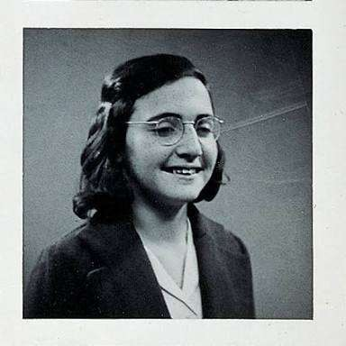
Margot Frank
Anne’s older sister. Margot was born in Frankfurt in 1926. She receives little attention in Anne’s diary, and Anne does not provide a real sense of Margot’s character.
Anne thinks that Margot is pretty, smart, emotional, and everyone’s favorite. However, Anne and Margot do not form a close bond, and Margot mainly appears in the diary when she is the cause of jealousy or anger.
She dies of typhus in the concentration camp a few days before Anne does.

Slide 6
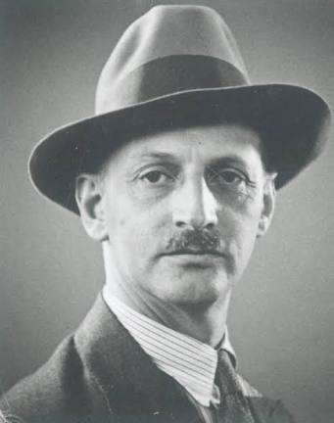
Otto Frank
Anne’s father. Otto is practical and kind, and Anne feels a particular kinship to him. He was born on May 12, 1889, into a wealthy Frankfurt family, but the
family’s international-banking business collapsed during the German economic depression that followed World War I.
After the Nazis came to power in Germany, Otto moved to Amsterdam in 1933 to protect his family from persecution.
There he made a living selling chemical products and provisions until the family was forced into hiding in 1942.

Slide 7
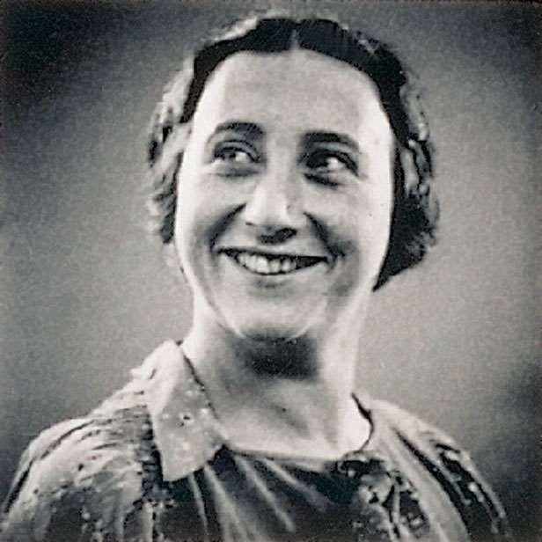
Edith Frank
Anne’s mother. Edith Hollander was originally from Aachen, Germany, and she married Otto in 1925.
Anne feels little closeness or sympathy with her mother, and the two have a very tumultuous relationship.
Anne thinks her mother is too sentimental and critical. Edith dies of hunger and exhaustion in the concentration camp at Auschwitz in January 1945.

Slide 8
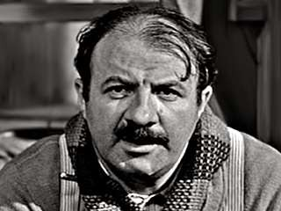
Mr. van Daan
The father of the family that hides in the annex along with the Franks and who had worked with Otto Frank as an herbal specialist in Amsterdam.
Mr. van Daan’s actual name is Hermann van Pels, but Anne calls him Mr. van Daan in the diary. According to Anne, he is intelligent, opinionated, pragmatic, and somewhat egotistical.
Mr. van Daan is temperamental, speaks his mind openly, and is not afraid to cause friction, especially with his wife, with whom he fights frequently and openly.

Slide 9
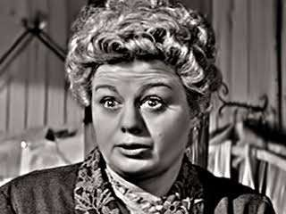
Mrs. van Daan
Mr. van Daan’s wife. Her actual name is Auguste van Pels, but Anne calls her Petronella van Daan in her diary.
Anne initially describes Mrs. van Daan as a friendly, teasing woman, but later calls her an instigator She is a fatalist and can be peŠy egotistical, flirtatious, stingy, and disagreeable.
Mrs. van Daan frequently complains about the family’s situation—criticism that Anne does not admire or respect. Mrs. van Daan does not survive the war, but the exact date of her death is unknown.

Slide 10
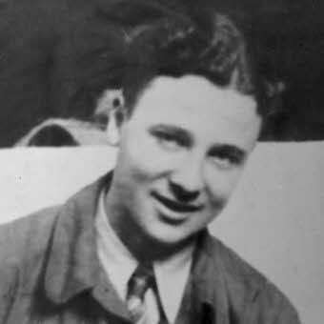
Peter Van Dan
The teenage son of the van Daans, whose real name is Peter van Pels.
Anne first sees Peter as obnoxious, lazy, and hypersensitive, but later
they become close
friends. Peter is quiet, timid, honest, and sweet to Anne, but he does not share her strong convictions.

Slide 11
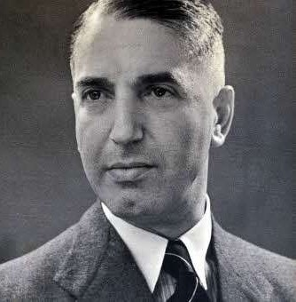
Albert Dussel
A dentist and an acquaintance of the Franks who hides with them in the annex.
His real name is Fritz Pfeffer, but Anne calls him Mr. Dussel in the diary. Anne finds Mr. Dussel particularly difficult to deal with because he shares a room with her, and she suffers the brunt of his odd personal hygiene habits, pedantic lectures,
and controlling tendencies.
Mr. Dussel’s wife is a Christian, so she does not go into hiding, and he is separated from her. He dies on December 20, 1944, at the Neuengamme concentration camp.

Slide 12
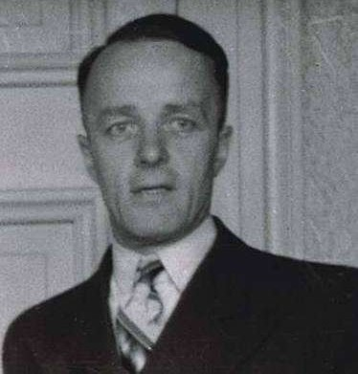
Mr. Kugler - A man who helps hide the Franks in the annex Victor Kugler is arrested along with Kleiman in 1944 but escapes in 1945.
He immigrates to Canada in 1955 and dies in Toronto in 1981. Mr. Kugler is also referred to as Mr. Kraler.

Slide 13
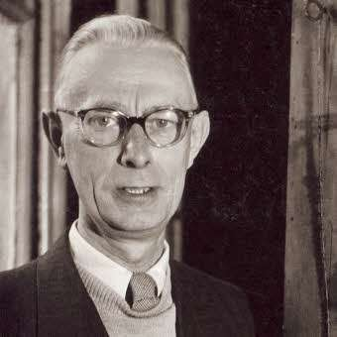
Mr. Kleiman - Another man who helps the Franks hide.
Johannes Kleiman is arrested in 1944 but released because of poor health. He remains in Amsterdam until his death in 1959.
Mr. Kleiman is also referred to as Mr. Koophuis

Slide 14
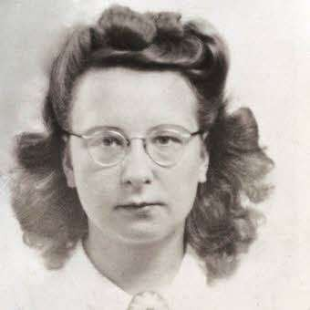
Bep Voskuijl - A worker in OŠo Frank’s office. Elizabeth (Bep) Voskuijl helps the family by serving as a liaison to the outside world. She remains in Amsterdam until her death in 1983.

Slide 15
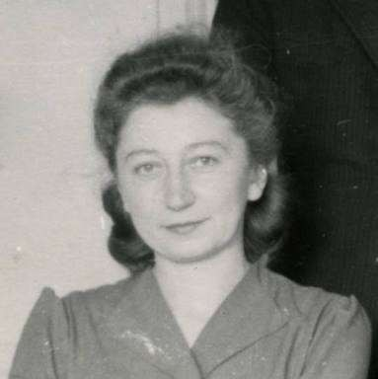

Miep Gies - A secretary at OŠo’s office who helps the Franks hide.
A er the Franks are arrested, she stows the diary away in a desk drawer and keeps it there, unread, until OŠo’s return in 1945. She died in 2010 at the age of 100.

Slide 16
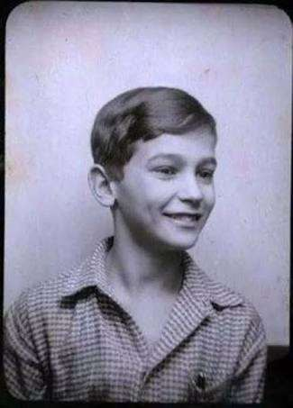
Peter Schiff - The love of Anne’s life from the sixth grade.
Peter Schiff is a boy one year older than Anne.
She has dreams about him while in the annex. Peter Schiff is also referred to as Peter Wesse.

Slide 17
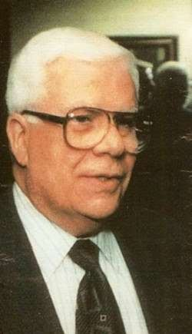
Hello Silberberg - A boy with whom Anne has an innocent, though romantic relationship before she goes into hiding.
Hello is also referred to as Harry Goldberg.

Slide 18
Summary
The book begins on Anne's thirteenth birthday, June 12, 1942. She receives as a present from her parents a diary, among other presents.
She thinks about it for several days and decides to write letters as her diary entries, she addresses each letter to Kitty.
Kitty is a fabricated friend, someone in which Anne can expose her deepest feelings to.
Anne's family has emigrated to Holland from Germany for two reasons, the first is Mr. Frank has taken a job there and the second is to move away from the Nazi Party.
The Nazis are making life very restrictive for the Jewish people in Germany.

Slide 19
Summary
Even though they have left Germany, the Jewish restrictions of the Nazi Party still exist in Holland.
They all are required to wear a yellow star on their clothing, attend only Jewish schools, shop at Jewish stores and other restrictions also apply.
The full impact of the restrictions and horrors of the Nazi Party are felt by the family on the day Anne's sister, Margot, is called up.
This means that she is to be taken away, in all probability to a concentration camp. The family knew they would one day have to go into hiding and had been making preparations for the move, this just moved up the time table of when they would go.
On July 9, 1942 the Frank family moved into the building which housed the business that employed Mr. Frank.
The rooms were above the warehouse floor and were referred to by Anne as the "Secret Annex".

Slide 20
Summary
The family was joined a few days later by the Van Daan family. This family consisted of Mr. and Mrs. Van Daan and their son Peter, who was a little older than Anne.
These two families try to get along as best they can, of course, not everyone is happy with the
situation.
Anne feels as if everything she does is fodder for the adults to use to criticize her. The
group also decides to make room for an eighth member, Mr. Dussel.
He is a dentist, whose wife is in America. He is recommended by Miep, a young woman who worked for Mr. Frank.
There are a number of people helping the families survive in the "Secret Annex", they include Miep and her husband Henk, Elli, and Mr. Koophuis.
There are also others who take a smaller role in helping them survive World War II.
Anne and her mother do not get along at all. Anne also feels as if she cannot behave in a manner that pleases any of the adults.

Slide 21
Summary
Her situation with her mother comes to a head one night as Mrs. Frank asks Anne if she, instead of Mr. Frank, can say Anne's prayers with her. Anne refuses her mother's request. Her mother tells Anne that she will try not to force her to love her.
The war is also exacting a toll on everyone. The people helping the families in the "Secret Annex" are becoming ill.
This is a twofold problem because they are an extension of the families in the Annex so the group is worried about the well-being of their helpers.
Another part of this is if the helpers are ill then the families are not able to receive food and other necessities for survival.

Slide 22
Summary
They are also being plagued with burglaries at the building. Several times burglars have tried and sometimes succeeded to break into the building.
The fear is they may hear the families and report them to the Gestapo resulting in everyone being taken away to concentration camps.
As the war continues on and Anne finds out about how more and more Jews are being sent to concentration camps, she has difficulty dealing with her emotions.
She is very happy to be safe and free from having to go to a concentration camp; she is also feeling guilty for this same safety because she knows her friends do not have this same secure feeling. The talk of invasion by the english also causes anxiety for Anne and the other.

Slide 23
Summary
On September 10, 1943 Anne records in her diary the fall of Italy. This brings joy to those living in Holland and the world.
This means the war is inching closer to its end.
The Van Daan's are out of money; their only hope is to sell some of their clothing.
The problem is Mrs. Van Daan does not want to sell her prized fur coat. The coat could bring in an infusion of much needed cash for the family, but she wants to hang on to it.
Mr. Van Daan convinces her to sell it so that the family can have money to buy food and other necessities.
As the war continues on and Anne finds out about how more and more Jews are being sent to concentration camps, she has difficulty dealing with her emotions.
She is very happy to be safe and free from having to go to a concentration camp; she is also feeling guilty for this same safety because she knows her friends do not have this same secure feeling. The talk of invasion by the English also causes anxiety for Anne and the other.

Slide 24
Summary
They do not know what will happen to them if the English invade.
Will the Germans try to flood the city endangering the lives of everyone there?
Anne is also in need of a confidant so she chooses Peter Van Daan to be that person. She chooses Peter because he is quiet and she feels he will keep her secrets for her. This relationship becomes complicated as her feelings for Peter range between friend to boyfriend.
Finally on June 6, 1944 the invasion occurs. The D-day invasion is a source of great joy for everyone in occupied Europe. The members who live in the "Secret Annex" hope to be able to leave in October 1944. Anne's final diary entry is about her two selves, the outer self which is cheerful and outgoing and the inner self which tries to be more serious and become a better person.
This diary shows the isolation of those living in the "Secret Annex". It also explores the feelings of a young girl as she starts to mature. We are left with the feeling of actually knowing these people, which makes their fate even harder to accept.

Slide 25
M O R A L
Why Records are Important
Anne's detailed diary gave us insights into what life was like for Jews who were in hiding

